Slide 1


ELECTRICAL AND ELECTRONICS ENGINEERING & USER INTERFACE
Design and Development of a Gesture-Controlled Robot Car Using Arduino and Wireless Communication Modules

Slide 2
TEAM MEMBERS
P.Deekshith cb.sc.u4aie24039
S.Dheeraj cb.sc.u4aie24050
S.V.Dhiraj cb.sc.u4aie24052
S.Sathwik cb.sc.u4aie24051

Slide 3
INTRODUCTION
A robotic car driven by hand gestures, using tilt to move forward, backward, left, right, or stop.
Aims to showcase intuitive control through sensors and wireless communication.
Built with a 4-wheel chassis, two Arduino UNOs, MPU6050 sensor, two HC-05 Bluetooth modules, L298N motor driver, and four 9v batteries.
Hand tilts detected by MPU6050 are sent via Bluetooth to control the car’s motors.
Serves as an educational project and prototype for gesture-based robotic systems.
Provides hands-on experience in Arduino programming, sensor integration, and wireless tech.

Slide 4
OBJECTIVES
Develop a robotic car controlled by hand gestures using tilt-based inputs.
Integrate sensors and wireless communication for seamless gesture-to-motion control.
Demonstrate real-time data transmission between transmitter and receiver via Bluetooth.
Provide a hands-on learning platform for Arduino programming and sensor interfacing.
Create a prototype for intuitive, gesture-based robotic systems.

Slide 5
METHODOLOGY
STEP 1: Component Setup & Roles
Arduino Uno (Hand Part): Captures hand movements using MPU6050, processes the gesture data, and sends commands via HC-05 (Master) Bluetooth.
Arduino Uno (Car Part): Receives Bluetooth commands via HC-05 (Slave) and controls the car movement using the L298N Motor Driver.
Power Supply: Two 9V batteries—one for each Arduino circuit.
STEP 2: MPU6050 Sensor Integration (Hand Part)
The MPU6050 ( Accelerometer) is attached to the hand or glove.
It detects tilt or directional motion:
Tilt forward → Move Forward
Tilt backward → Move Backward
Tilt left/right → Turn Left/Right
Steady/Flat hand → Stop
The sensor communicates with the Arduino using I2C (SCL/SDA pins).

Slide 6
STEP 3: Processing Gestures into Commands (Hand Arduino)
The Arduino reads real-time values (like pitch, roll, or angle) from the MPU6050.
Thresholds are set to interpret gestures. For example:
If pitch angle > +15° → send "F" (Forward)
If pitch angle < -15° → send "B" (Backward)
If roll angle > +15° → send "R" (Right)
If roll angle < -15° → send "L" (Left)
Otherwise → send "S" (Stop)
These single-letter commands are sent wirelessly via HC-05 Master.
STEP 4 :Wireless Communication (Bluetooth)
HC-05 Bluetooth Modules are configured as:
Master (Hand Arduino) — initiates the connection
Slave (Car Arduino) — waits and receives data
They pair automatically when powered and within range (~10 meters).
Hand Arduino sends command via Serial to Master HC-05 → Slave HC-05 receives → passed to Car Arduino.

Slide 7
STEP 5: Command Reception & Motor Control (Car Arduino)
Lack of Brand Visibility
Car Arduino reads serial input from HC-05 Slave.
Based on the received command:
"F" → Move all 4 motors forward
"B" → Move all 4 motors backward
"L" → Left motors slow/stop, right motors move → turn left
"R" → Right motors slow/stop, left motors move → turn right
"S" → Stop all motors
These signals are sent to L298N Motor Driver, which drives the 4 DC motors.
By defining your unique value proposition and creating a consistent brand identity, we ensure your business stands out and remains memorable in the minds of your target audience.
Ineffective Digital Presence
Through data-driven insights, we tailor strategies to maximize online visibility, engage your audience, and drive meaningful interactions, converting online engagements into tangible business outcomes.
STEP 6: L298N Motor Driver Wiring
Lack of Targeted Lead Generation
Connected to 4 DC motors (2 on each side).
Receives direction and enable signals from the Car Arduino.
Powered by the car’s 9V battery.
By leveraging strategic content, paid advertising, and personalized engagement tactics, we ensure that your marketing efforts are focused on reaching and converting the right audience.

Slide 8

STEP 7: Power Supply Management
Thynk Unlimited
9V Battery 1: Powers the Hand Arduino + MPU6050 + Master HC-05
9V Battery 2: Powers the Car Arduino + L298N + Motors
Make sure batteries are securely connected and voltage-regulated if needed.
STEP 8: Testing and Calibration
Test each direction separately.
Ensure Bluetooth connection is stable before full test.

Slide 9
CIRCUIT DIAGRAM
🤚 Hand Side (Transmitter):
🚗 Car Side (Receiver):
MPU6050 → Arduino Uno
VCC → 3.3V / 5V
GND → GND
SDA → A4
SCL → A5
HC-05 (Master) → Arduino Uno
VCC → 5V
GND → GND
TX → PIN 10
RX → PIN 11
Powered by 9V Battery
HC-05 (Slave) → Arduino Uno
VCC → 5V
GND → GND
TX → RX
RX → TX
L298N Motor Driver → Arduino
IN1–IN4 → Digital Pins (e.g., 8–11)
ENA, ENB → PWM Pins or 5V
OUT1–OUT4 → 4 DC Motors
12V → 9V Battery
GND → Arduino GND
Powered by 9V Battery
With a global perspective, our marketing agency has proudly served multinational clients, delivering tailored strategies that transcend borders and cultures, ensuring consistent brand success on a worldwide scale.

Slide 10
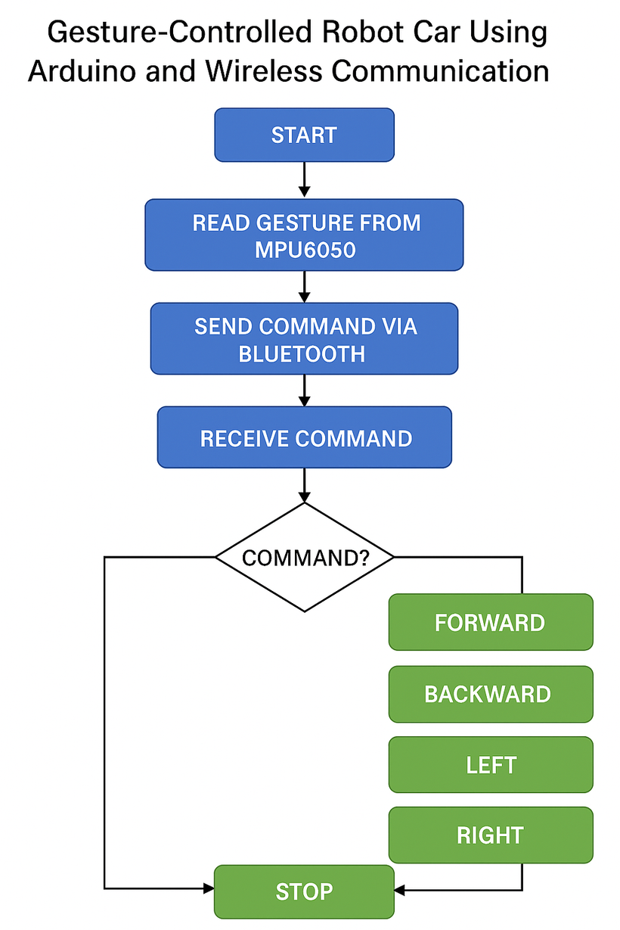
CLIENT’S SATISFACTION
STATISTIC

Slide 11
UID PART
STATISTIC
Thynk Unlimited
STEP 1: Component Selection
Selected ESP8266 NodeMCU as the main controller due to its built-in Wi-Fi capabilities.
Used L298N motor driver to control four DC motors.
Chose a 4-wheel chassis, geared DC motors, and a 9V battery for mobility.
STEP 2: Circuit Design and Hardware Connections
Connected the four DC motors to the L298N motor driver module.
Interfaced the motor driver inputs (IN1–IN4) with GPIO pins of the ESP8266.
Ensured a common ground between the ESP8266 and the motor driver.

Slide 12
STEP 3: Programming and Firmware Development
STATISTIC
Thynk Unlimited
Programmed the ESP8266 using the Arduino IDE.
Configured the ESP8266 in Access Point (AP) mode to create a Wi-Fi hotspot.
Developed a web server using the ESP8266WebServer library to handle directional commands.
STEP 4: Web Interface Creation
Designed an HTML-based control interface with buttons for Forward, Backward, Left, Right, and Stop.
Integrated JavaScript to send HTTP requests to the ESP8266 server on button press.

Slide 13
STEP 5: Motor Control Logic Implementation
STATISTIC
Thynk Unlimited
Mapped each web route to a specific motor control function using digital signals.
Defined separate functions for forward, backward, left turn, right turn, and stop.
STEP 6: Testing and Debugging
Connected to the ESP8266’s Wi-Fi using a smartphone.
Accessed the control interface via browser and tested all directional commands.

Slide 14
FURURE SCOPE
Add speed control by mapping tilt angles to PWM signals for dynamic motor speed adjustments.
Integrate obstacle avoidance using ultrasonic sensors to enhance autonomous navigation capabilities.
Develop a wearable glove interface for the MPU6050, improving user gesture precision.

Slide 15
RESULTS
The MPU6050 accurately detected hand tilts in four directions (forward, backward, left, right).
Mapped hand gestures to specific character commands (F, B, L, R, S).
Bluetooth HC-05 modules established a stable connection between the hand (transmitter) and the car (receiver).
Commands were successfully sent from the transmitter to the receiver unit in real time.
The 4-wheel robot car responded correctly to each gesture.
All four wheels received proper drive signals from the L298N motor driver.
Direction and speed control were accurately managed by the Arduino using PWM (if implemented).
All modules worked well together: Arduino, MPU6050, Bluetooth modules, L298N, and motors.
Stable power supply ensured continuous operation during testing.

Slide 16
UID PART RESULTS
ESP8266 NodeMCU created a Wi-Fi hotspot and hosted a web server for wireless control.
HTML interface with JavaScript sent real-time commands to the ESP8266 via browser.
L298N motor driver controlled four DC motors for smooth car movement.
System worked reliably with stable Wi-Fi control and responsive motor actions.

Slide 17
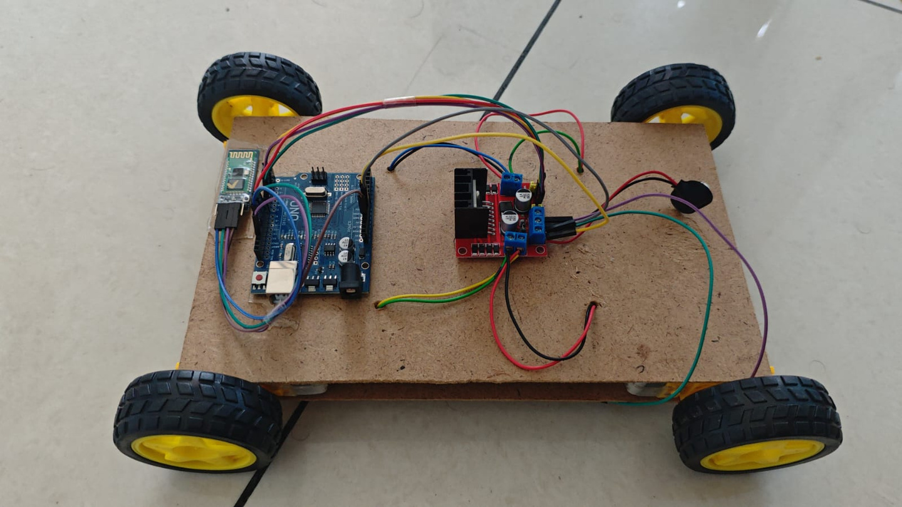
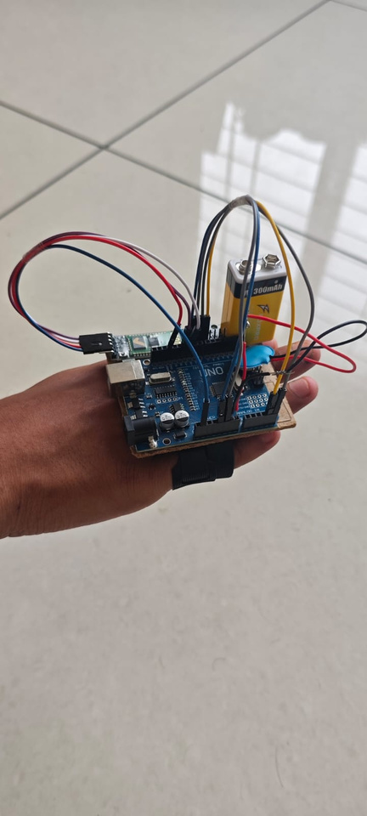

Slide 18
THANK YOU

